Slide 1
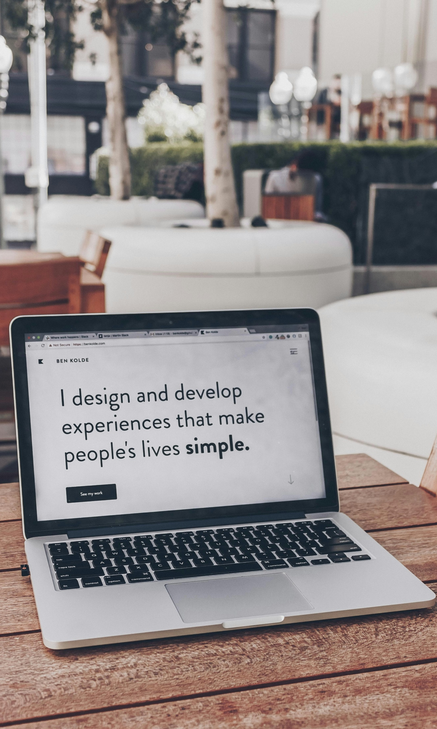


Building Accessible Products in Modern UI Development
How Scrum Teams Can Add Accessibility to their Definition of Done
Scrum Day India 2025

Slide 2

Let’s Test Our Awareness!

Slide 3


Slide 4
What challenge does the character face?
Dyslexia
A boy struggles with reading and writing.
Use readable fonts like OpenDyslexic or avoid overly decorative fonts.
Keep layout clean, with proper spacing and high contrast.
Use simple language and short paragraphs.
Avoid flashing animations or confusing navigation.
How can we make our product more inclusive?

Slide 5
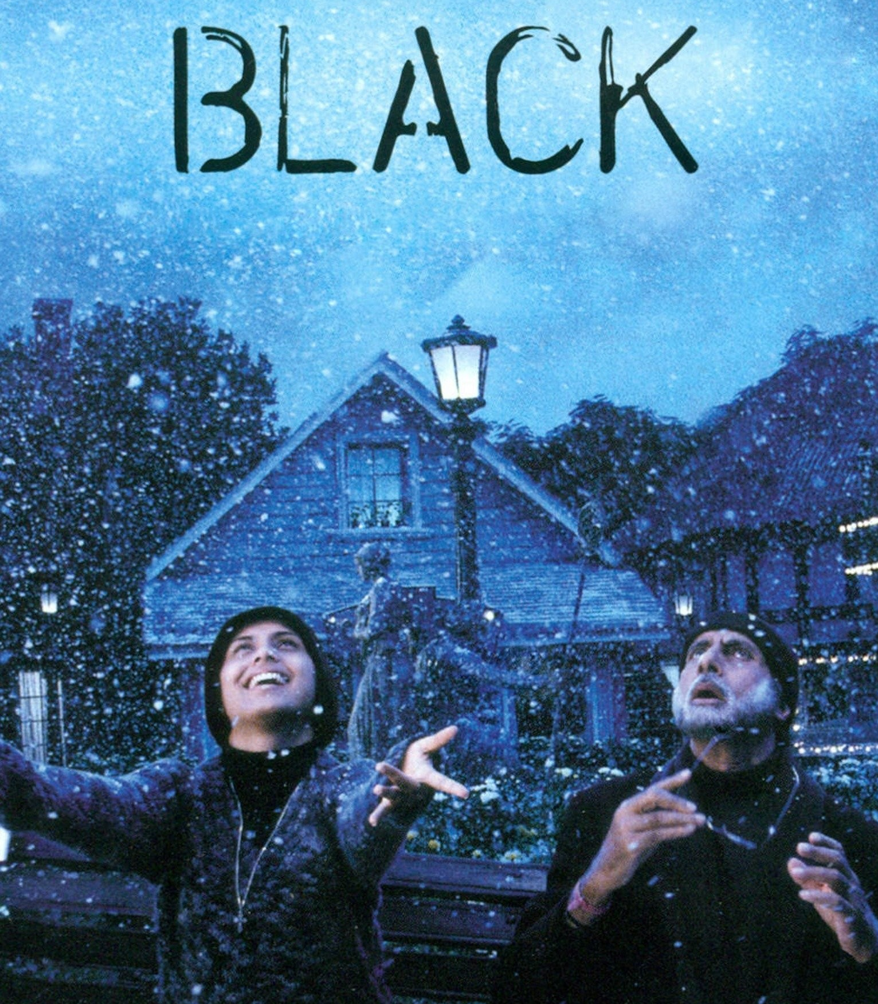

Slide 6
Deaf and Blind
A girl who cannot see or hear.
Story of how support and empathy can transform a life.
What challenge does the character face?
Provide multi-sensory feedback (haptic/tactile cues)
Ensure keyboard navigation and consistent layout for assistive devices
Add transcripts or captions for all media.
Use ALT text for all images.
Ensure buttons, links, and headings are clearly defined.
How can we make our product more inclusive?

Slide 7
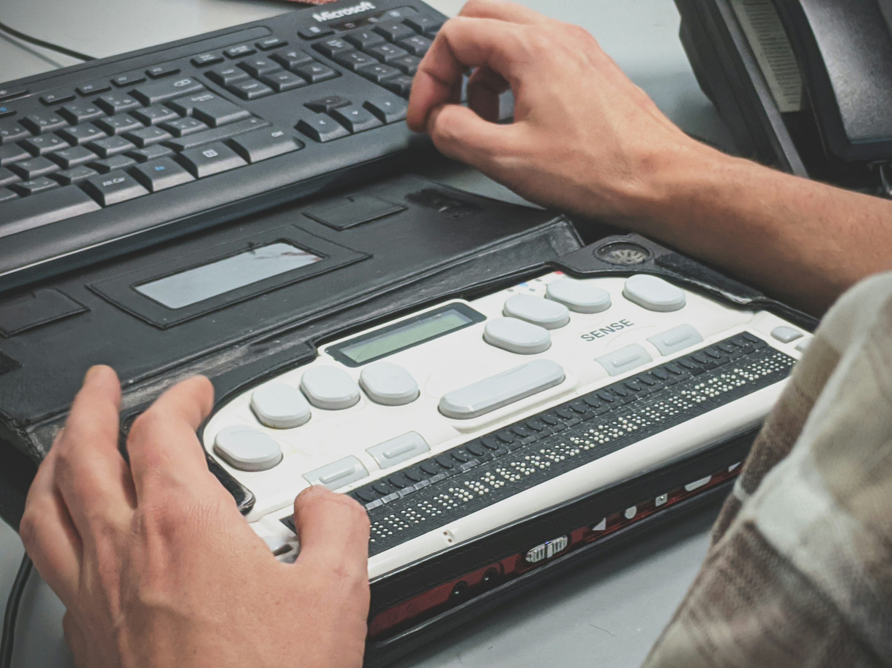
Braille

Slide 8


Slide 9
Mild intellectual disability (low IQ).
Story about a simple man with big life experiences.
What challenge does the character face?
Use simple, plain language for content.
Provide audio or visual guidance instead of text-heavy instructions.
Design with clear navigation and large, easy-to-click elements.
Support text-to-speech features.
Avoid time-based actions or complex user flows.
How can we make our product more inclusive?

Slide 10

What We’ll Cover
We’ll explore what accessibility really means, why it matters, and how Scrum teams can use simple practice (and a little AI help) to make their products usable by everyone.
01.
What is Accessibility?
02.
Why it Matters
03.
Common Delivery Pitfalls
04.
Tools & AI Helpers
05.
Practical Examples & Quick Demo
06.
Tips & Resources
07.
Thank You!
Notes:
Common mistakes developer makes

Slide 11

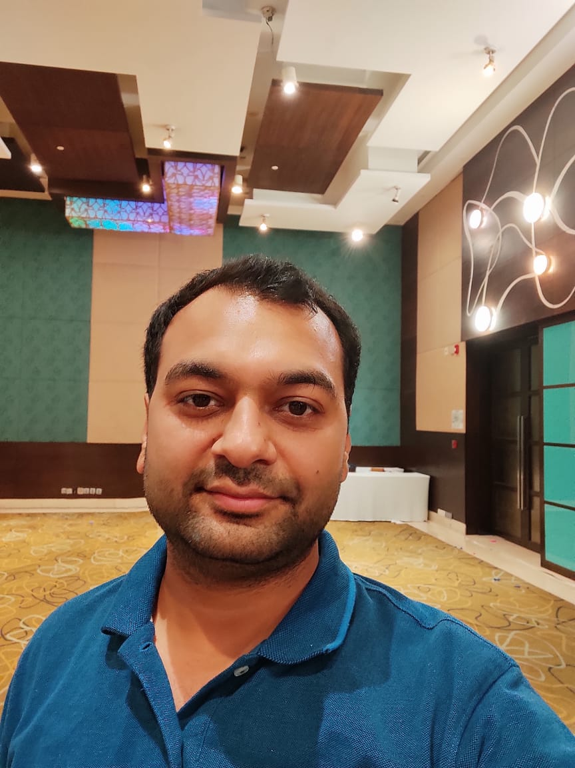




About Me…
Experience
13+ years in web development, BFSI & enterprise apps (Wells Fargo Bank, Deutsche Bank, Citibank)
Angular Expert Certified, 10+ years with Angular
Currently building low-code/no-code UI frameworks at SBS
Focused on modern UI, accessibility, and product quality
👋Hi, I am
Himanshu Goel
Architect @ SBS, Noida
Community & Interests
Attending tech meetups and conferences
Blogger & open-source contributor
Love to build side projects, travel, and explore new food. 😋
https://x.com/himanshugoelmca
https://github.com/HimanshuGoel/
https://www.linkedin.com/in/himanshu-goel-mca/

Slide 12

Before We Start…
Everything I’m sharing today reflects my own experience and learnings — not the official view of my employer or Scrum Day India.
This session is purely for learning and knowledge-sharing.
Some tools or frameworks mentioned may have alternatives — feel free to explore what works best for you!
Also, any logos or screenshots are used for illustration only and belong to their respective owners.

Slide 13
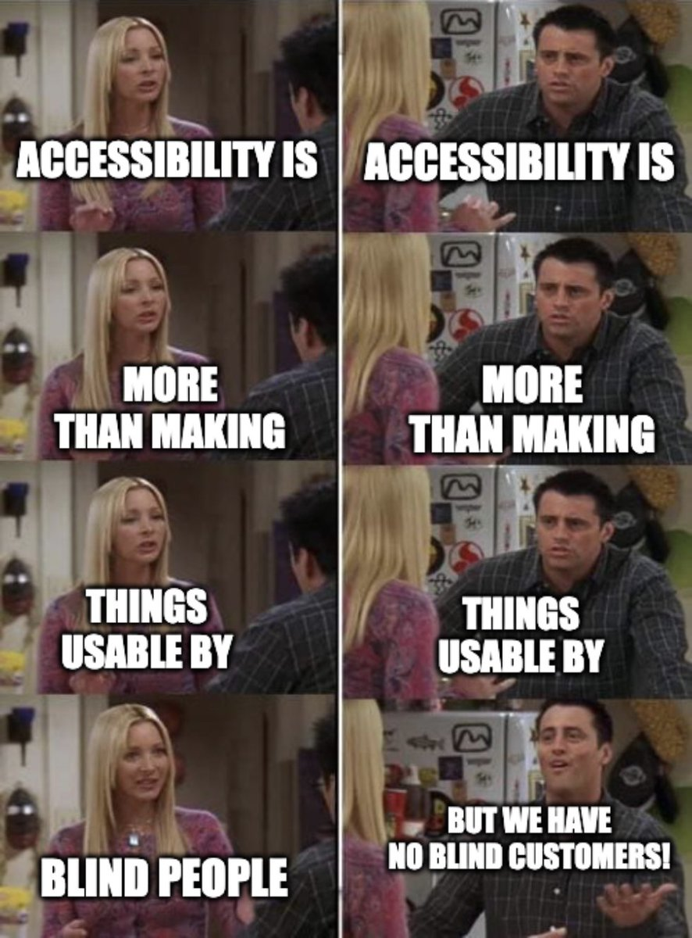
(abbreviated as a11y)
What is Accessibility?

Slide 14
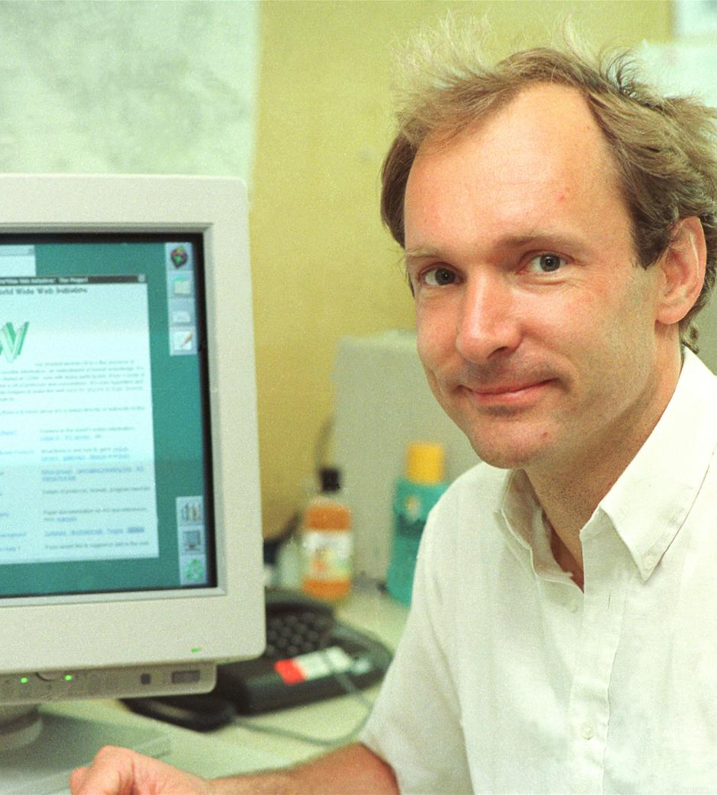

”
The power of the Web is in its universality. Accessibility for everyone, regardless of disability, is an essential aspect.
Tim Berners-Lee → Web Developer

Slide 15

To Put It Simply...
Accessibility means making products that work for everyone, including people with different disabilities.

Slide 16
To Put It Simply...
Accessibility means making products that work for everyone, including people with different disabilities.
Vision
Example: A blind user browsing your app with a screen reader.

Slide 17
To Put It Simply...
Accessibility means making products that work for everyone, including people with different disabilities.
Vision
Hearing
Example: A blind user browsing your app with a screen reader.
Example: A user who relies on captions to watch your tutorial video.

Slide 18
To Put It Simply...
Accessibility means making products that work for everyone, including people with different disabilities.
Vision
Hearing
Example: A blind user browsing your app with a screen reader.
Example: A user who relies on captions to watch your tutorial video.
Understanding
Example: A person with learning difficulty needing clear and simple content.

Slide 19
To Put It Simply...
Accessibility means making products that work for everyone, including people with different disabilities.
Vision
Hearing
Example: A blind user browsing your app with a screen reader.
Example: A user who relies on captions to watch your tutorial video
Understanding
Mobility
Example: A person with learning difficulty needing clear and simple content.
Example: A user who can't use a mouse and uses only a keyboard.

Slide 20
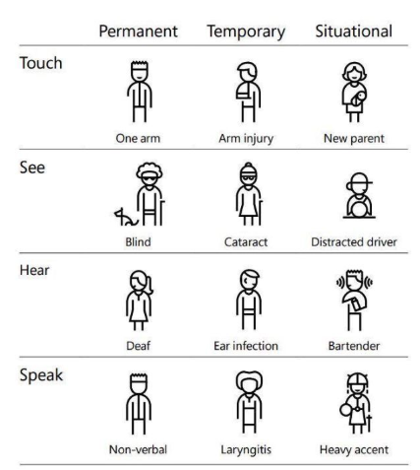
Accessibility also helps people in a variety of situations – not just with long-term disabilities.
Types of Accessibility Needs
Permanent
A person born blind or with a missing limb
Temporary
A broken arm, eye surgery, or ear infection
Situational
Using a phone in bright sunlight
Watching a video in a noisy train
Holding a baby with one hand

Slide 21
Why Accessibility Matters

Slide 22

4 Simple Reasons to Care About Accessibility
Reason #1
Digital Equality
The web is a public space — everyone deserves full access.
It’s not just good tech, it’s digital justice.

Slide 23
4 Simple Reasons to Care About Accessibility
Reason #1
Reason #2
Legal Requirement
Digital Equality
Required by laws like Section 508 in US, European Accessibility Act 2025 (EAA), and similar laws exists worldwide.
The web is a public space — everyone deserves full access.
It’s not just good tech, it’s digital justice.
Based on global standards like WCAG (Web Content Accessibility Guidelines).
Avoids legal risks and promotes ethical responsibility.

Slide 24
4 Simple Reasons to Care About Accessibility
Reason #1
Reason #2
Legal Requirement
Digital Equality
Required by laws like Section 508 in US, European Accessibility Act 2025 (EAA), and similar laws exists worldwide.
The web is a public space — everyone deserves full access.
It’s not just good tech, it’s digital justice.
Based on global standards like WCAG (Web Content Accessibility Guidelines).
Avoids legal risks and promotes ethical responsibility.
Reason #3
Better Business Outcomes
More users = more reach = more impact.
Improves SEO through semantic HTML and better content structure.
Competitive advantage.

Slide 25

4 Simple Reasons to Care About Accessibility
Reason #1
Reason #2
Legal Requirement
Digital Equality
Required by laws like Section 508 in US, European Accessibility Act 2025 (EAA), and similar laws exists worldwide.
The web is a public space — everyone deserves full access.
It’s not just good tech, it’s digital justice.
Based on global standards like WCAG (Web Content Accessibility Guidelines).
Avoids legal risks and promotes ethical responsibility.
Reason #3
Reason #4
Better Business Outcomes
Promotes Good Design
More users = more reach = more impact.
Many “accessibility features” became everyday features (think dark mode, captions, skip links).
Improves SEO through semantic HTML and better content structure.
It forces you to design with intention, not assumption.
Competitive advantage.

Slide 26

Accessibility in Numbers
97.4%
Websites fail at least one WCAG 2.1 AA requirement
71%
Users leave if a product isn’t accessible – that’s wasted sprint effort and lost customer value.
5,500
Accessibility lawsuits filed in the U.S. in 2023 alone
$8T
Combined global disposable income of people with disabilities and their families
86%
Accessibility issues are detectable through automation testing –
but still ignored. It can be part of Definition of Done.
Data sourced from UserWay, WebAIM, 3Play Media, Accessibility Works, Global Business Coalition for Education, and The Valuable 500

Slide 27

Most Common Accessibility Issues 96% of issues fall into these 6 categories
Hard-to-read text (low-contrast colors)
79.1%
Images without descriptions (no alt text)
55.5%
Forms without instructions (missing labels)
48.2%
Links that go nowhere (empty links)
45.4%
General Misconception…
“We are making the web accessible for disabled people — actually, we are making the web accessible for our future selves.”
Buttons with no meaning (empty buttons)
29.6%
Pages without a set language (screen readers can’t read properly)
15.8%

Slide 28
Common Delivery Pitfalls

Slide 29

No Accessibility Acceptance Criteria
Accessibility Seen as Later Work
Not in
Definition of Done
Reviews Skip Accessibility Checks
Dynamic Content
not Explained
Small misses that quietly create big barriers!
Rely Only
on Visuals
No Keyboard Testing
Auto-Playing Content
Unclear Error Messages

Slide 30
Available Tools and AI Helpers

Slide 31


Tools That Make Accessibility Easier
For Developers
For POs / Scrum Masters
Framework Support
Lighthouse Reports & Accessibility Insights
UI Components & ARIA Helpers
Browser Tools (Wave, Web Toolbar)
Built-in Form Validators
Checklists & toolkits (WCAG, Inclusive Design Toolkit)
Axe-core & Cypress-axe
Collaboration & feedback (UserZoom)
Screen Readers (NVDA, VoiceOver)

Slide 32

AI Helpers
Making accessibility easier, faster, and smarter for your team.
Sign Language to Voice/Chat
Google’s Project Relate, MS AI for Accessibility

Slide 33

AI Helpers
Making accessibility easier, faster, and smarter for your team.
Sign Language to Voice/Chat
Personal Reading Helper
Google’s Project Relate, MS AI for Accessibility
Microsoft Immersive Reader, Read&Write, GPT paraphrase prompts

Slide 34

AI Helpers
Making accessibility easier, faster, and smarter for your team.
Sign Language to Voice/Chat
Personal Reading Helper
Auto Audit + Fix Suggestions
Google’s Project Relate, MS AI for Accessibility
Microsoft Immersive Reader, Read&Write, GPT paraphrase prompts
axe-core + GPT workflows, Evinced, Accessibility Insights

Slide 35

AI Helpers
Making accessibility easier, faster, and smarter for your team.
Sign Language to Voice/Chat
Personal Reading Helper
Auto Audit + Fix Suggestions
Smart Screen Readers / Scene Description
Google’s Project Relate, MS AI for Accessibility
Microsoft Immersive Reader, Read&Write, GPT paraphrase prompts
axe-core + GPT workflows, Evinced, Accessibility Insights
Microsoft Seeing AI, Google Lookout

Slide 36

AI Helpers
Making accessibility easier, faster, and smarter for your team.
Voice Control Instead of Mouse or Keyboard
Google Assistant, Alexa for Apps, iOS Voice Control

Slide 37

AI Helpers
Making accessibility easier, faster, and smarter for your team.
Voice Control Instead of Mouse or Keyboard
Smart Captions & Audio Understanding
Google Assistant, Alexa for Apps, iOS Voice Control
Not just words people say, but also sounds or moods
Google auto-captions and Sound Notifications

Slide 38

AI Helpers
Making accessibility easier, faster, and smarter for your team.
Voice Control Instead of Mouse or Keyboard
Smart Captions & Audio Understanding
Emotion-Aware Interface
Google Assistant, Alexa for Apps, iOS Voice Control
Not just words people say, but also sounds or moods
UI adapts when AI senses frustration, stress or fatigue
Google auto-captions and Sound Notifications
Affectiva,
MS Emotion APIs

Slide 39

AI Helpers
Making accessibility easier, faster, and smarter for your team.
Voice Control Instead of Mouse or Keyboard
Smart Captions & Audio Understanding
Emotion-Aware Interface
Auto-translate + Localize Accessibility
Google Assistant, Alexa for Apps, iOS Voice Control
Not just words people say, but also sounds or moods
UI adapts when AI senses frustration, stress or fatigue
AI produces translated captions and alt-text for global users
Google auto-captions and Sound Notifications
Affectiva,
MS Emotion APIs
DeepL, Google Translate

Slide 40
Practical Examples

Slide 41
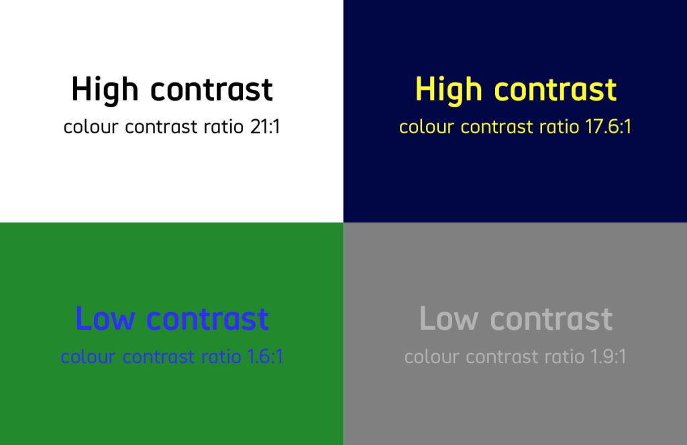
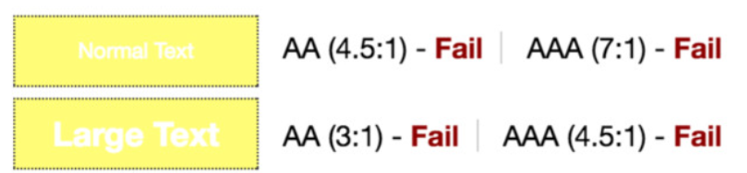
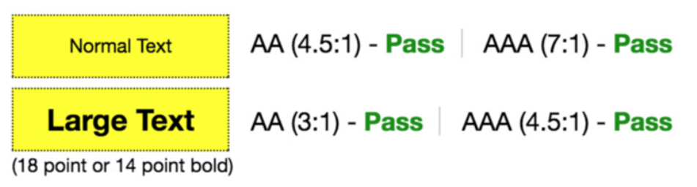

Slide 42
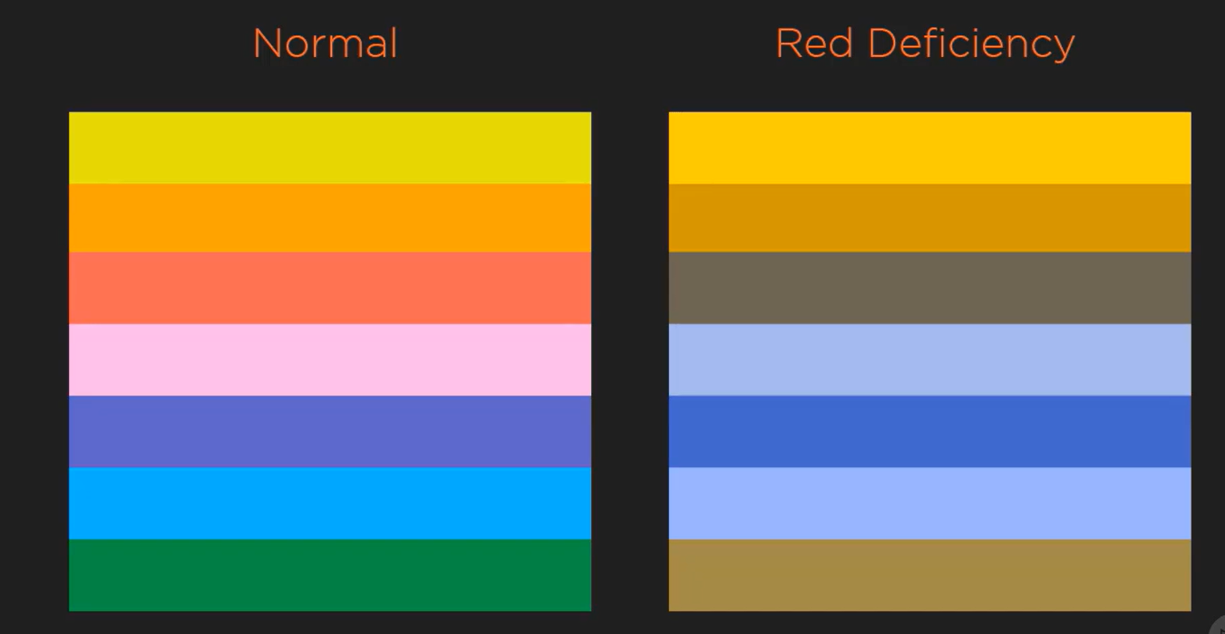
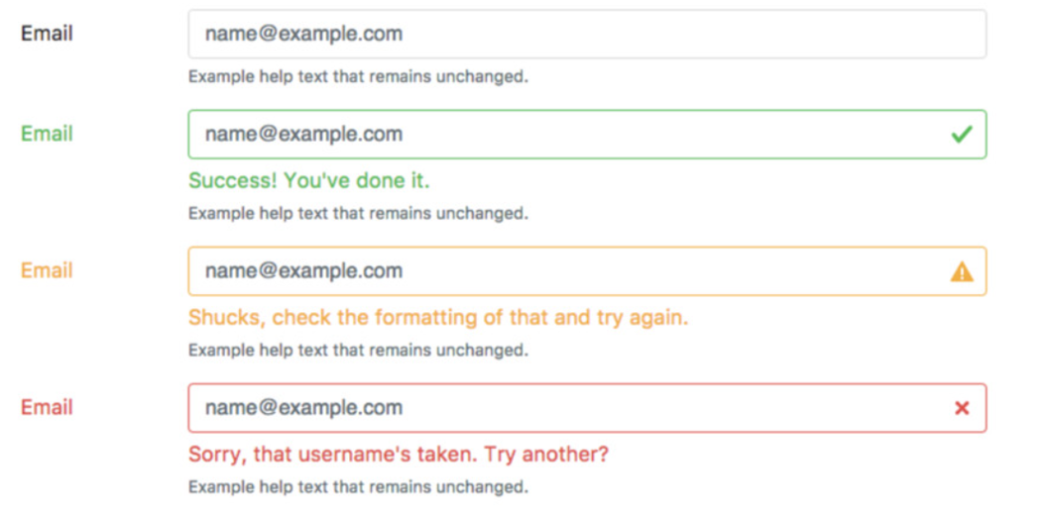
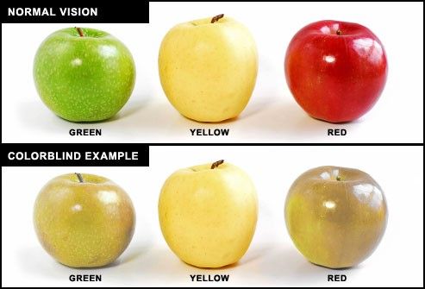
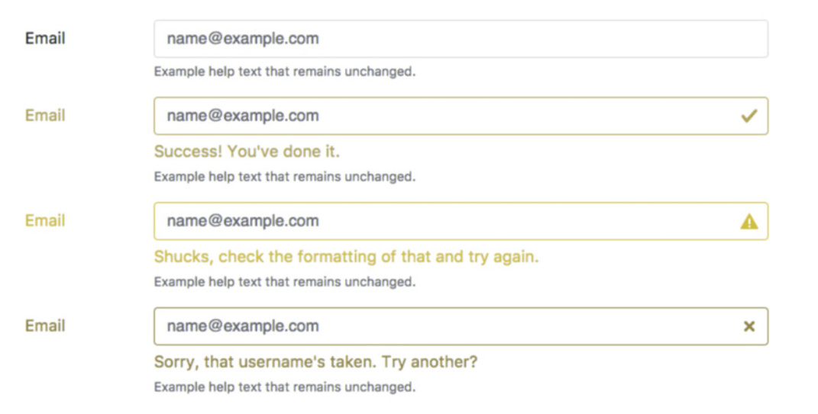

Slide 43
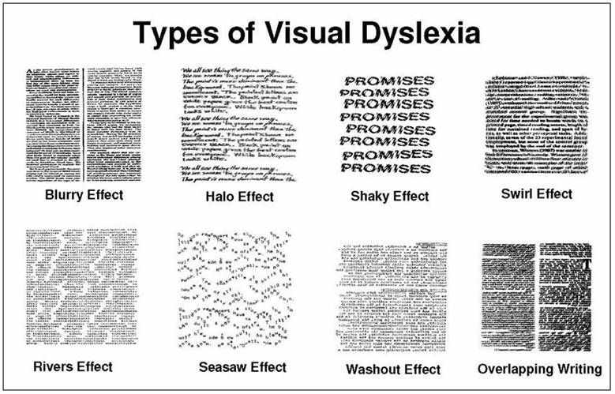
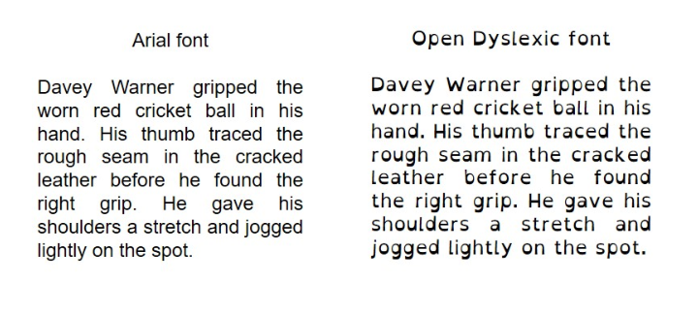

Slide 44
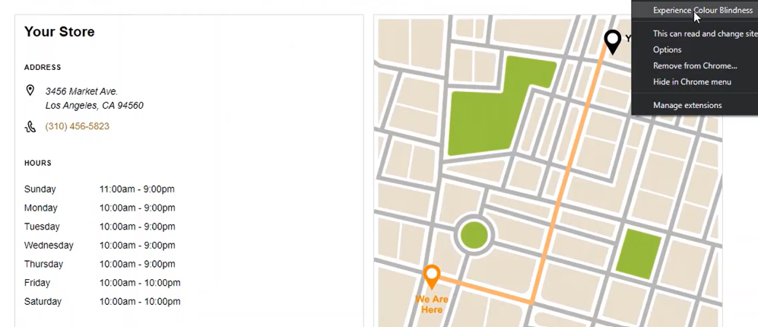
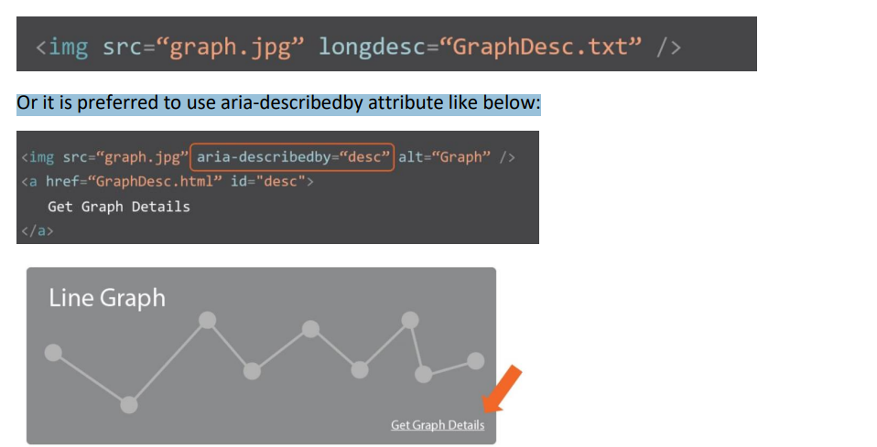
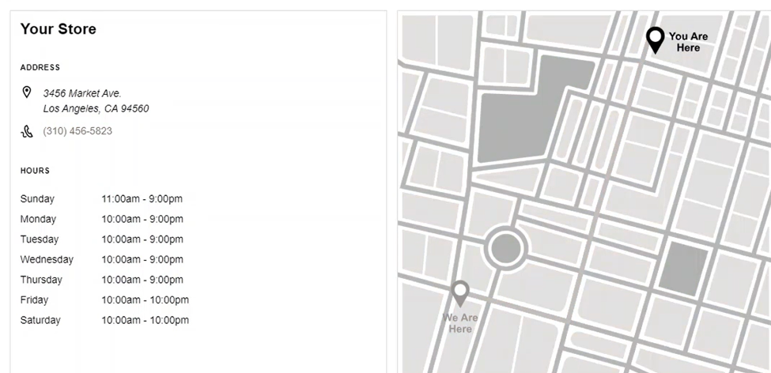
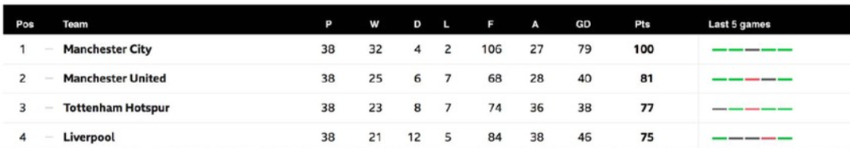
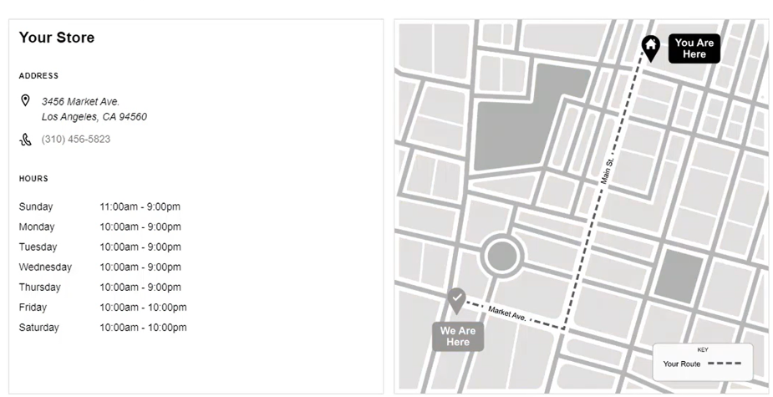
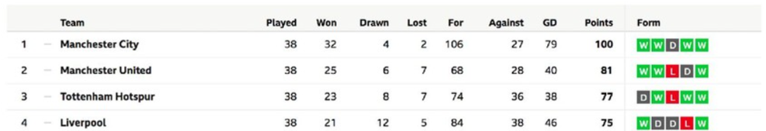

Slide 45
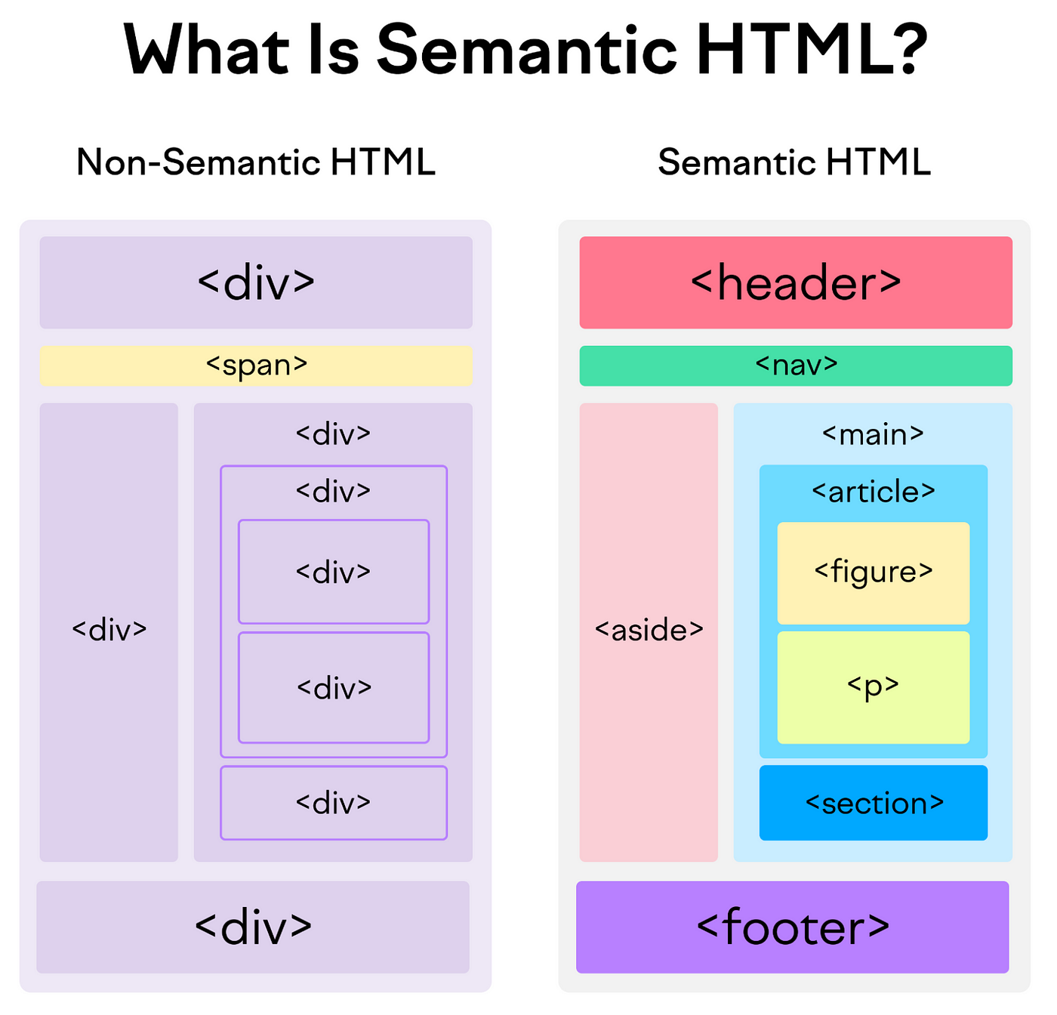
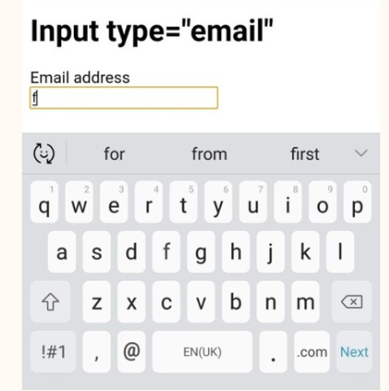
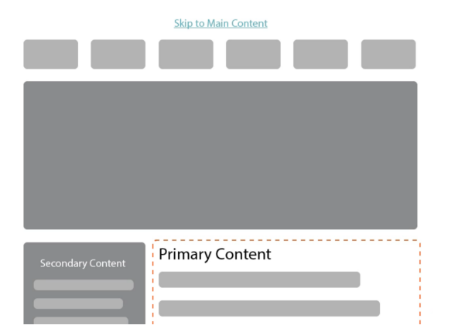
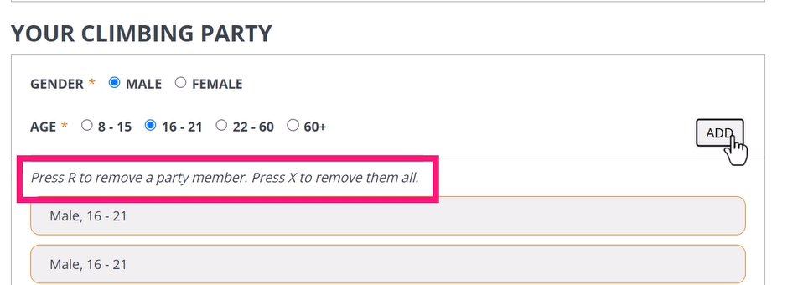

Slide 46
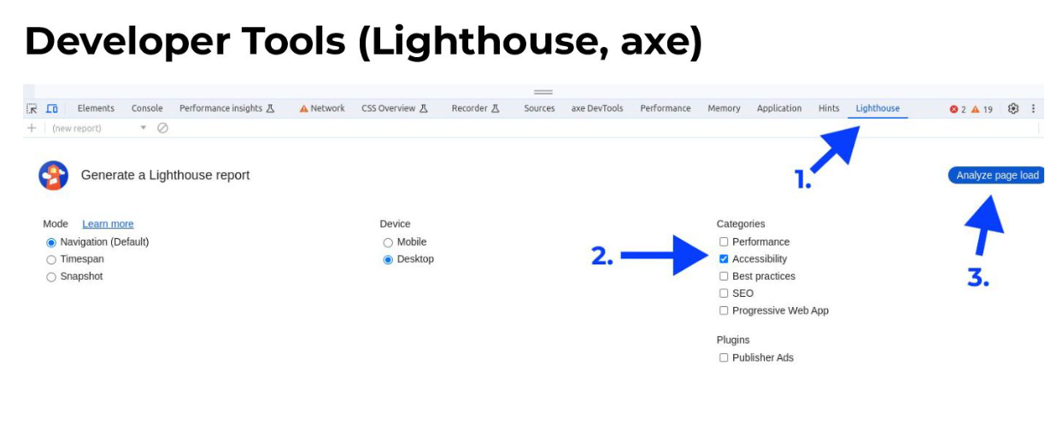
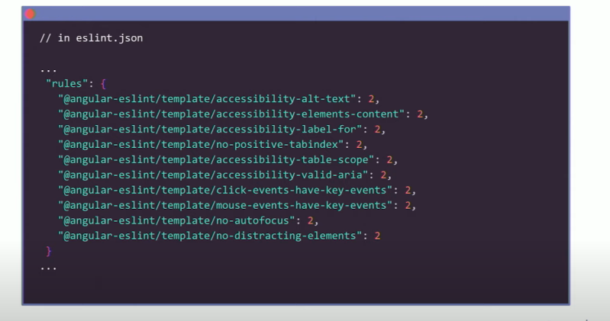
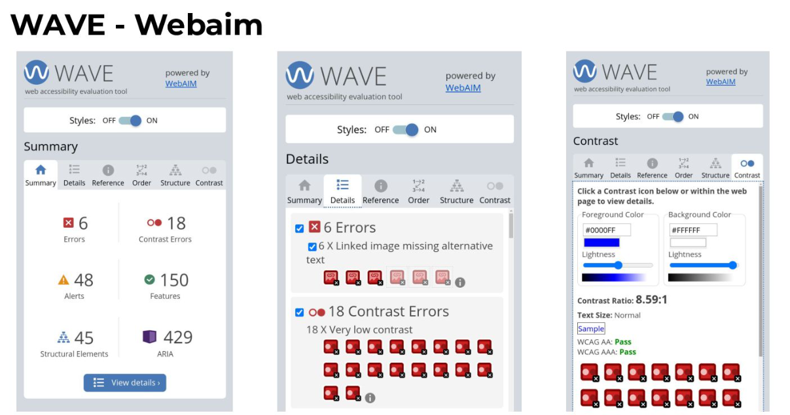
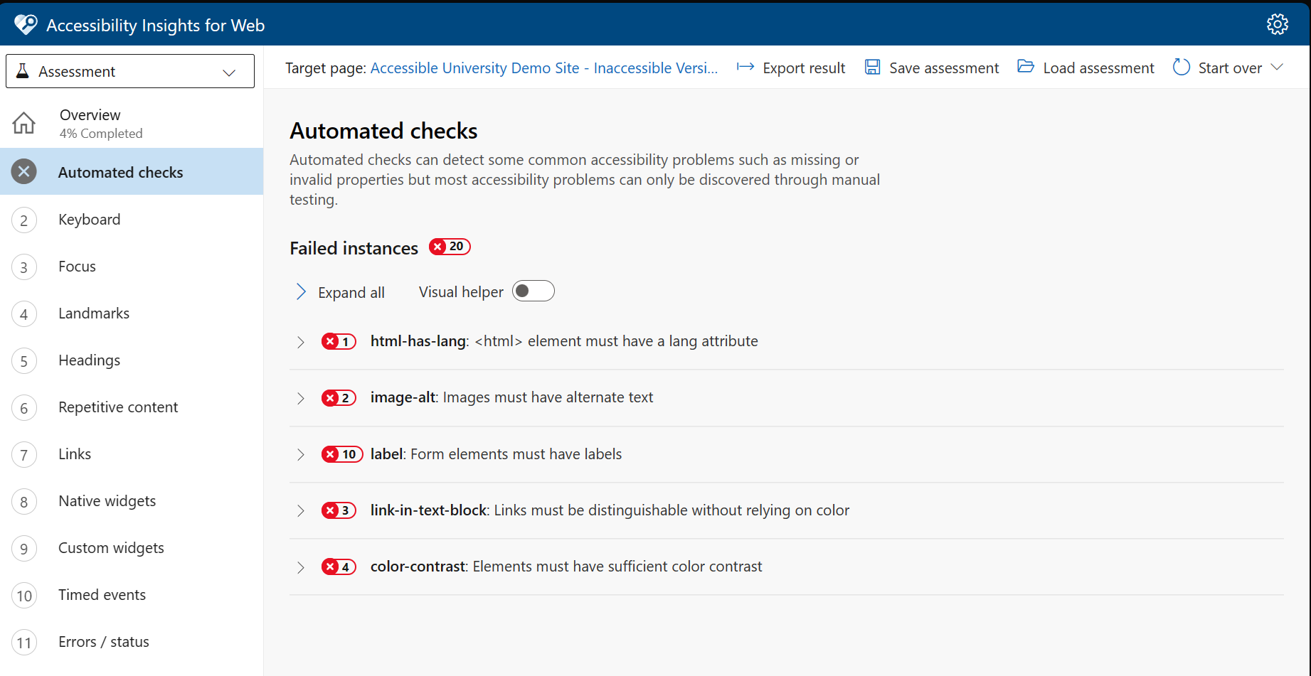

Slide 47
Quick Demo

Slide 48
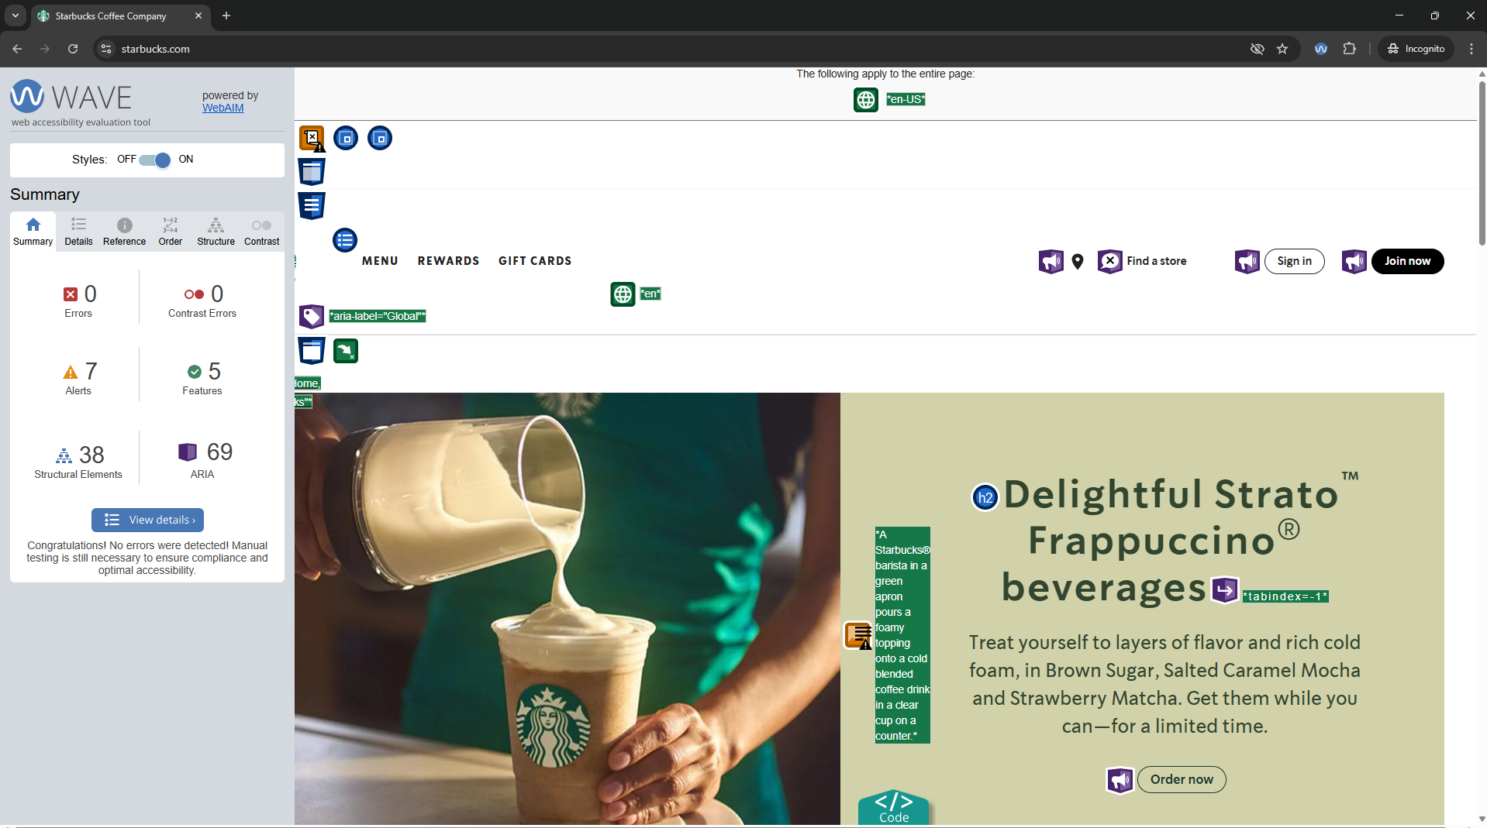

Slide 49
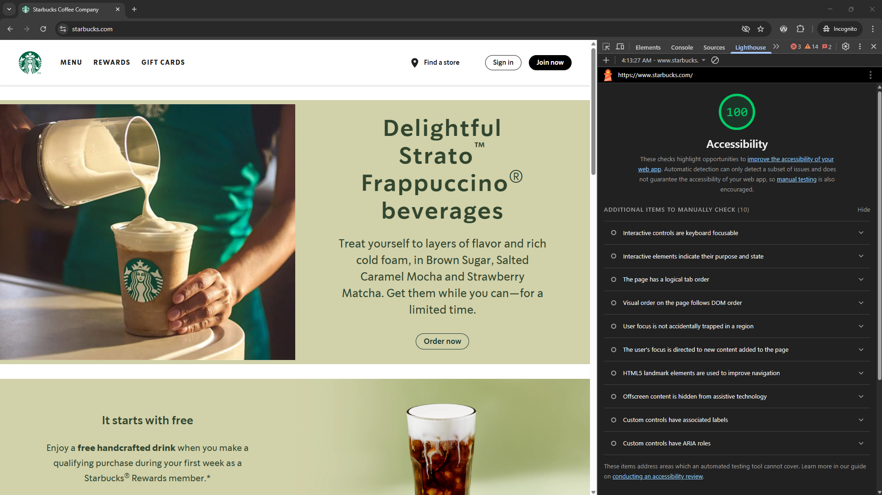

Slide 50
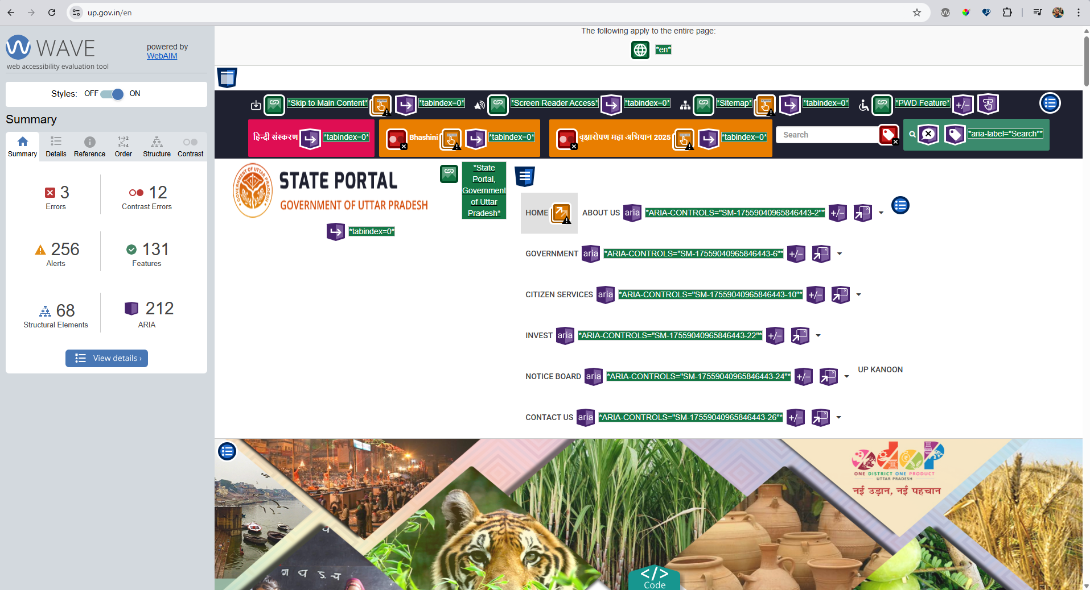

Slide 51
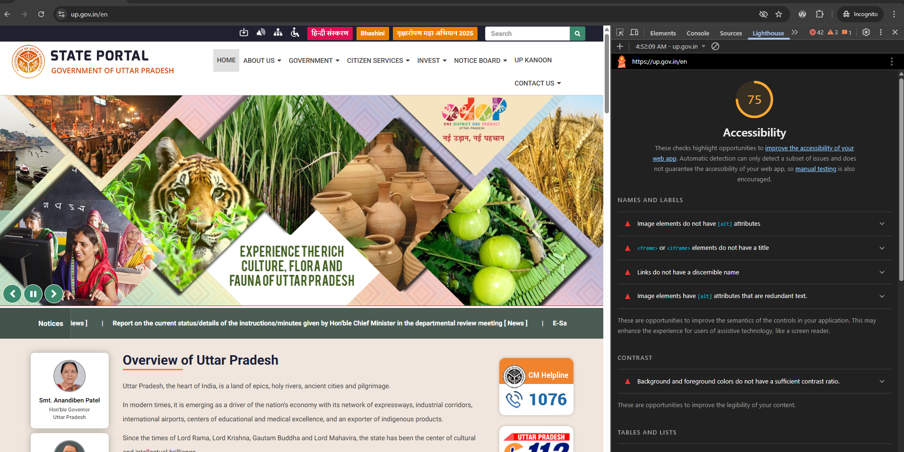

Slide 52
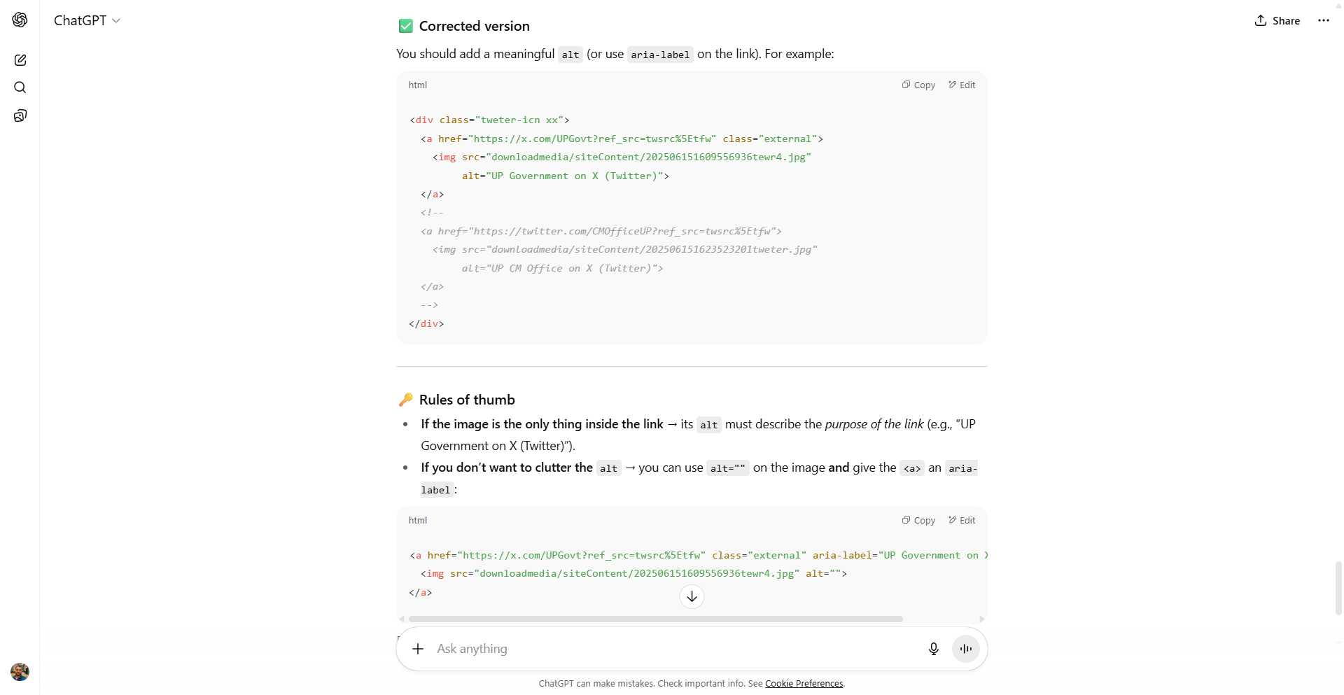

Slide 53
Tips and Resources

Slide 54
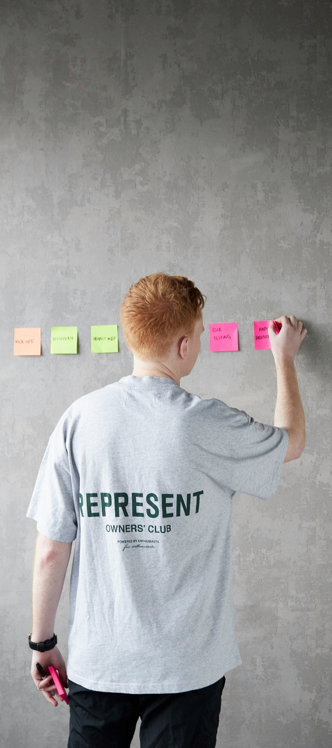
Tips That Help
Start Early
Design with Empathy
Think Keyboard First
Test with Real Users
Automate & Audit
Logs Bugs with a11y in Mind

Slide 55
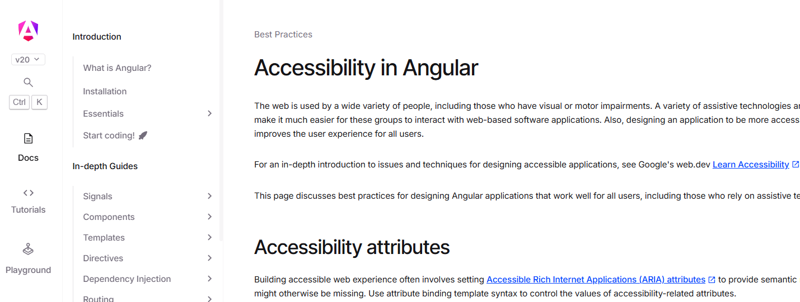
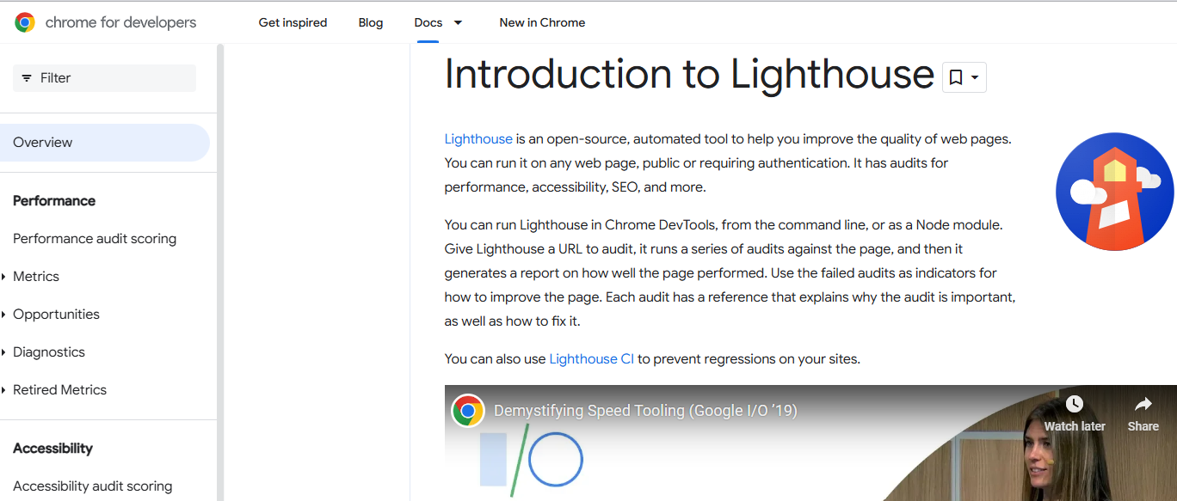
Learning Resources
The Accessibility Best Practices in Angular
https://angular.dev/best-practices/a11y
The Accessibility Best Practices in React
https://legacy.reactjs.org/docs/accessibility.html
Web Content Accessibility Guidelines (WCAG)
https://www.w3.org/WAI/standards-guidelines/wcag
Google Lighthouse
https://developer.chrome.com/docs/lighthouse/overview
The A11y Project
https://www.a11yproject.com
Microsoft Inclusive Design Toolkit
https://inclusive.microsoft.design

Slide 56

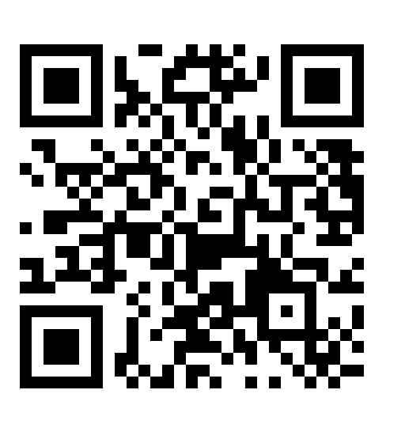

🙏
Thank You!
Everyone Here
&
Himanshu Goel

